Slide 1
10 years with DragonFlyBSD network stack
DragonFlyBSD project
sephe@dragonflybsd.org

Slide 2
Chapter 1 The current state of DragonFlyBSD’s network stack

Slide 3
Message passing and thread serialized
Asynchronous message passing.
Per-cpu network thread, aka netisr-N.
UIPC syscalls and NIC input path send messages to netisr-N.
Hard lift is done by netisr-N.

Slide 4
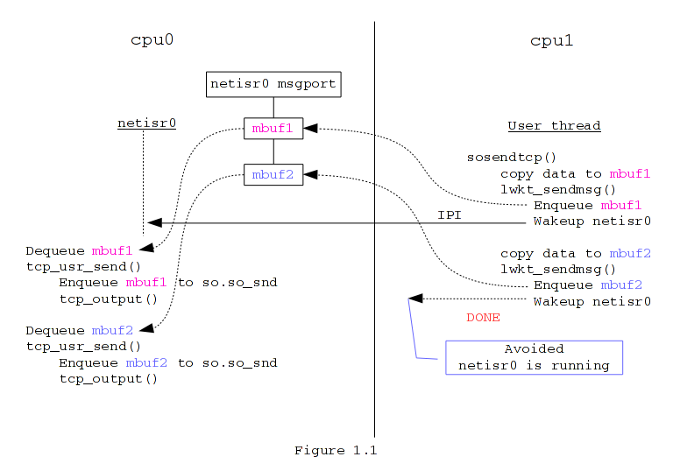
Message passing and thread serialized
Example:
UIPC sendto(2) syscall.
Message is embedded in mbuf.
Message sending is asynchronous.
Once mbuf1.msg is sent, move on to mbuf2 immediately.

Slide 5
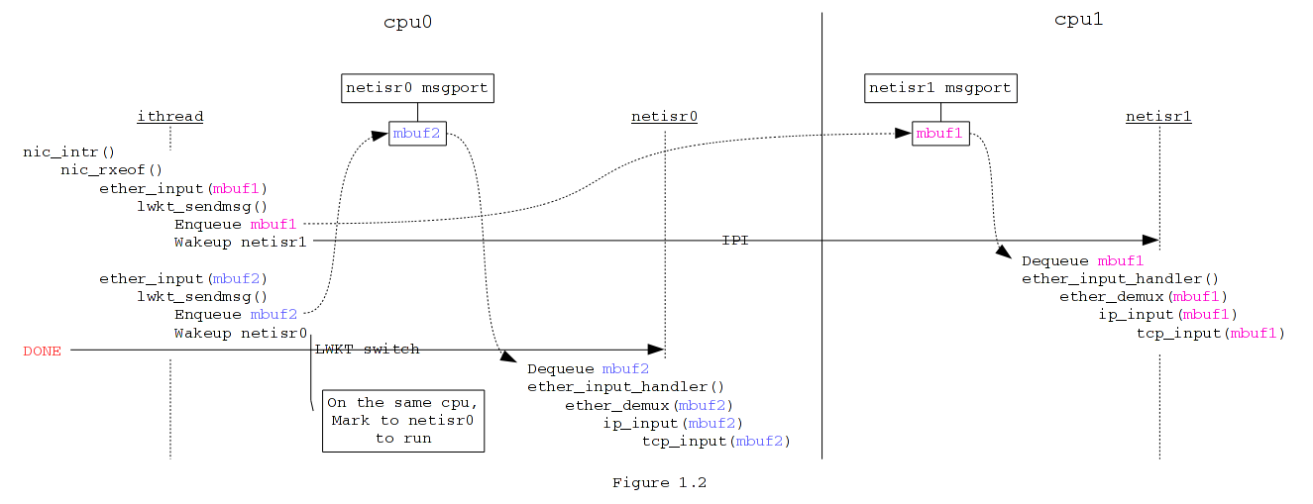
Message passing and thread serialized NIC input path

Slide 6
Network data replication and partition
Majority network data accessing from netisr-N is lockless or uncontended.
Replicate.
Routing table.
Partition.
TCP INPCBs.
Grow independently.
Cloned routes.

Slide 7
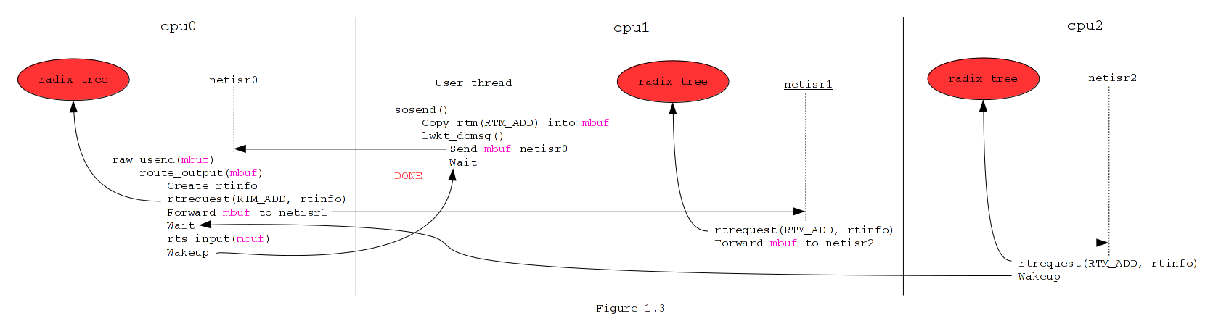
Network data replication and partition Replicate: routing table

Slide 8
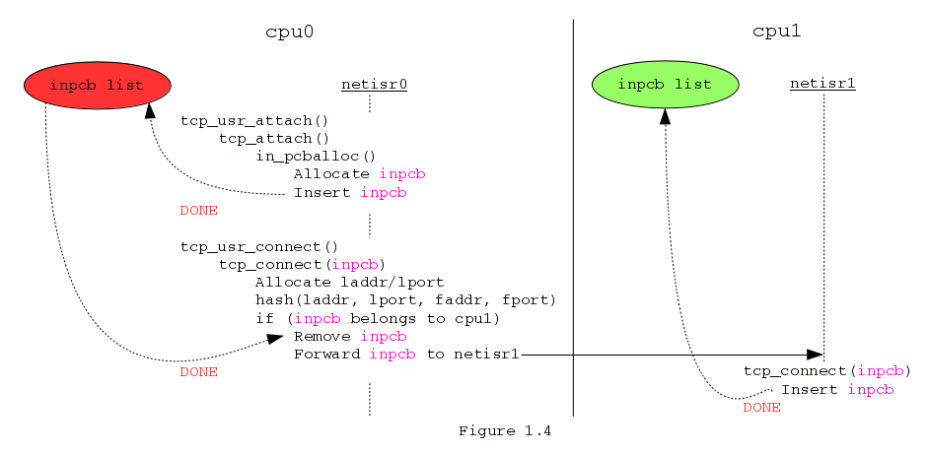
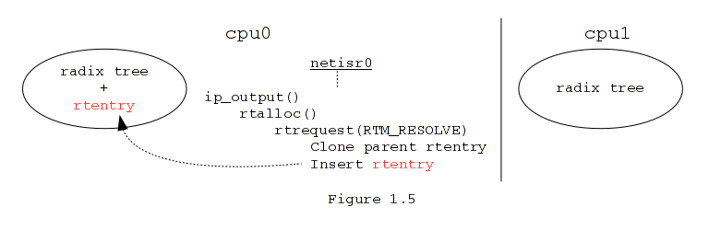
Network data replication and partition
Partition: TCP INPCBs
Grow independently: cloned routes

Slide 9
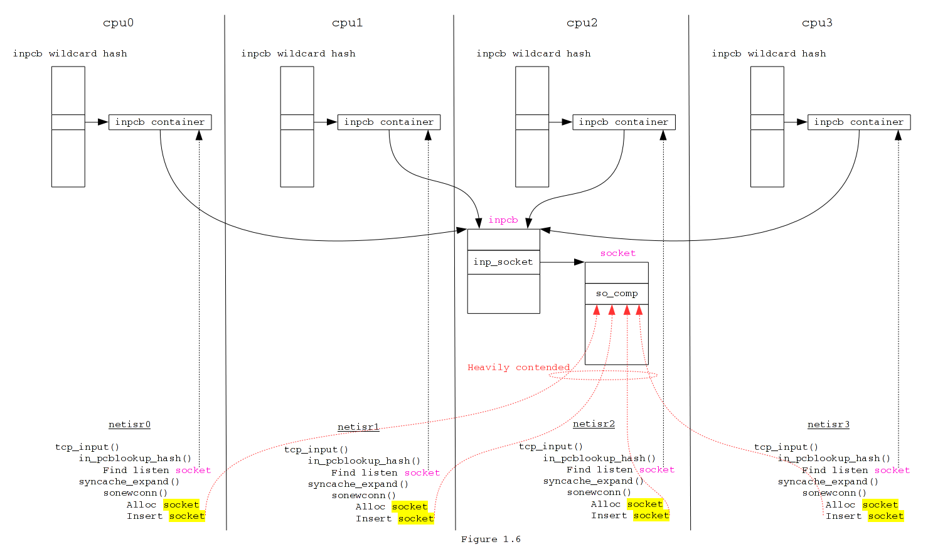
Network data replication and partition
Special replication:
TCP wildcard socket
Only references are replicated.
The “inpcb container”.
Wildcard hash table is lock free.
Contended heavily on the accept queue.

Slide 10
Symmetric receive side scaling (RSS)
RSS uses Toeplitz hash.
toeplitz(laddr, lport, faddr, fport, key)
Not 4-tuple commutative.
toeplitz(192.168.1.1, 3007, 192.168.1.2, 2003, key) = 0x9e51fb2a
toeplitz(192.168.1.2, 2003, 192.168.1.1, 3007, key) = 0x4c472df4

Slide 11
Symmetric receive side scaling (RSS)
What’s Symmetric RSS?
Only difference is how RSS key is generated.
Duplicate 2 bytes to create 40 bytes RSS key.
e.g. { 0x6d, 0x5a, 0x6d, 0x5a, 0x6d, 0x5a, …. }
4-tuple commutative.
toeplitz(192.168.1.1, 3007, 192.168.1.2, 2003, key) = 0xe501e501
toeplitz(192.168.1.2, 2003, 192.168.1.1, 3007, key) = 0xe501e501
RSS capable NICs have no issue to support it.
Call toeplitz_get_key().

Slide 12
Symmetric receive side scaling (RSS)
Computation burden reduction.
Use 2 pre-calculated result arrays.
Less error prone.
Host side uses toeplitz(laddr, lport, faddr, fport).
NIC side uses toeplitz(faddr, fport, laddr, lport).
Stepping stone for per-cpu state table for stateful firewalls.

Slide 13
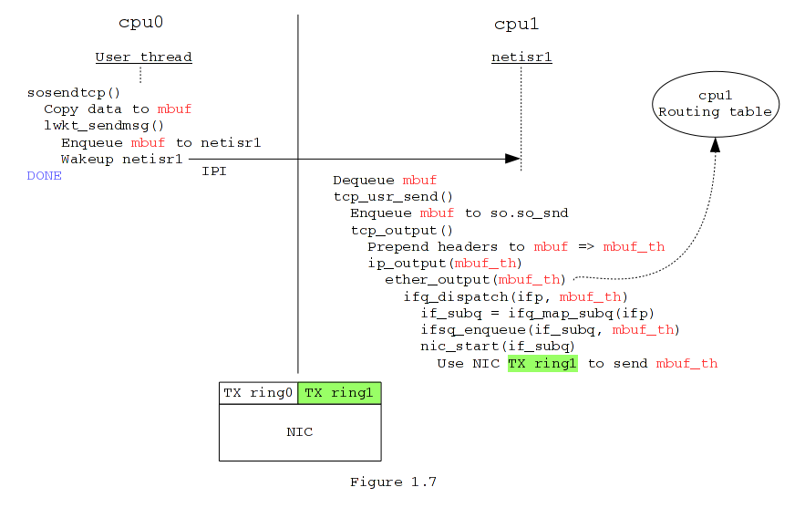
Piece everything together: data sending
Hash for the connected TCP socket is determined at:
connect(2)
sonewconn()

Slide 14
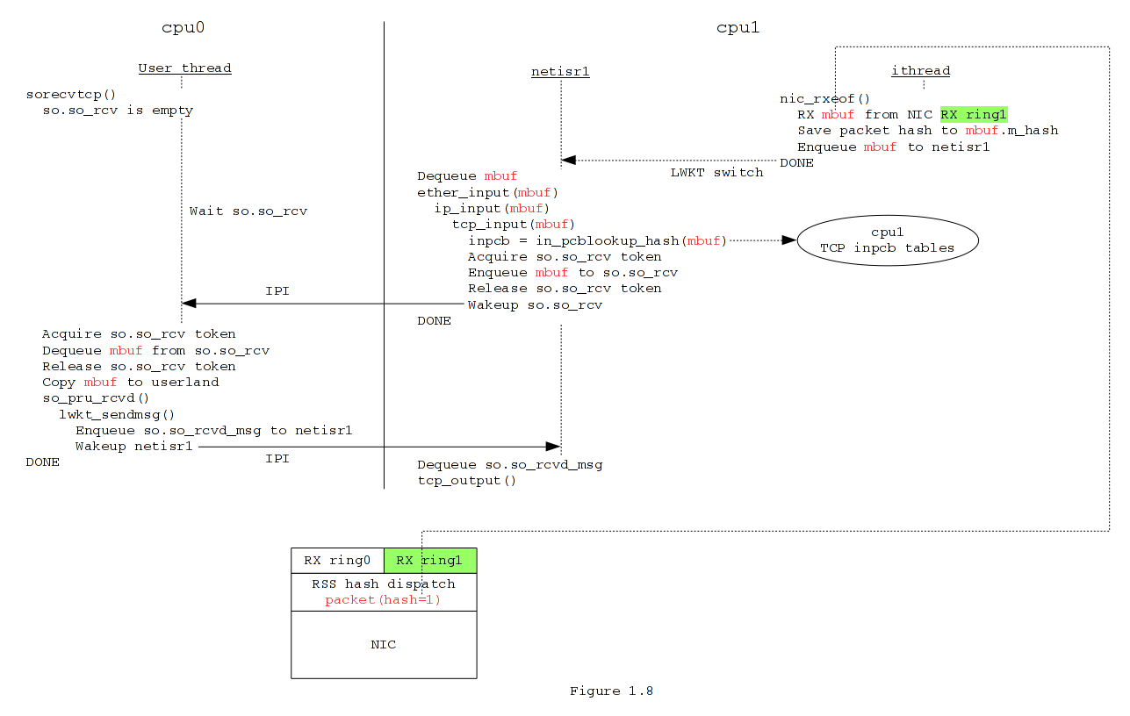
Piece everything together: data receiving

Slide 15
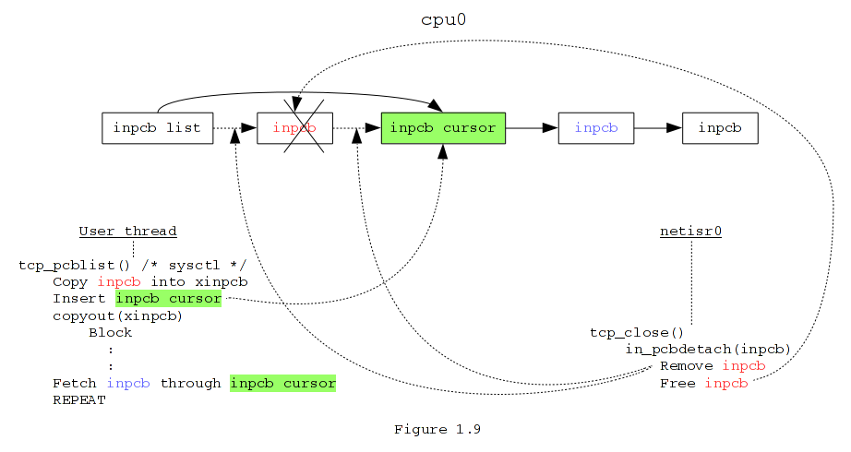
Accessing network data from non-netisr threads
e.g. INPCB list dump sysctl.
Migrate to cpu0.
Fetch one INPCB each time.
INPCB -> XINPCB.
Insert cursor INPCB.
copyout(XINPCB)
This may block.
INPCB list may be changed.
Fetch next INPCB through cursor INPCB.
Migrate to the next cpu.
….

Slide 16
Accessing network data from non-netisr threads
Required kernel scheduling features:
Kernel threads will only be preempted by interrupt kernel threads.
Interrupt kernel threads do not touch INPCB list.
Kernel threads will not be moved to other CPUs.

Slide 17
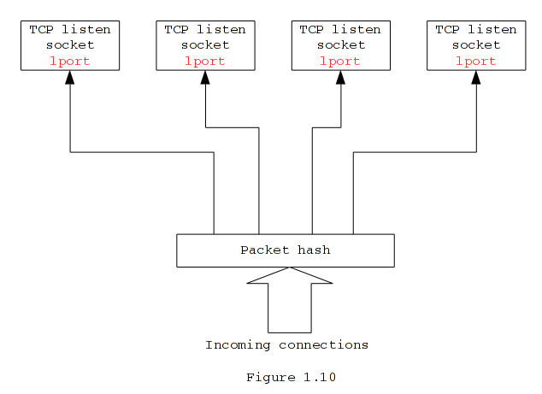
Google’s SO_REUSEPORT
A set of TCP sockets listening on the same lport.
Accepted sockets are distributed to the set of TCP listen sockets.
Based on SYN’s packet hash.
Improve workload distribution.
Reduce accept queue contention.

Slide 18
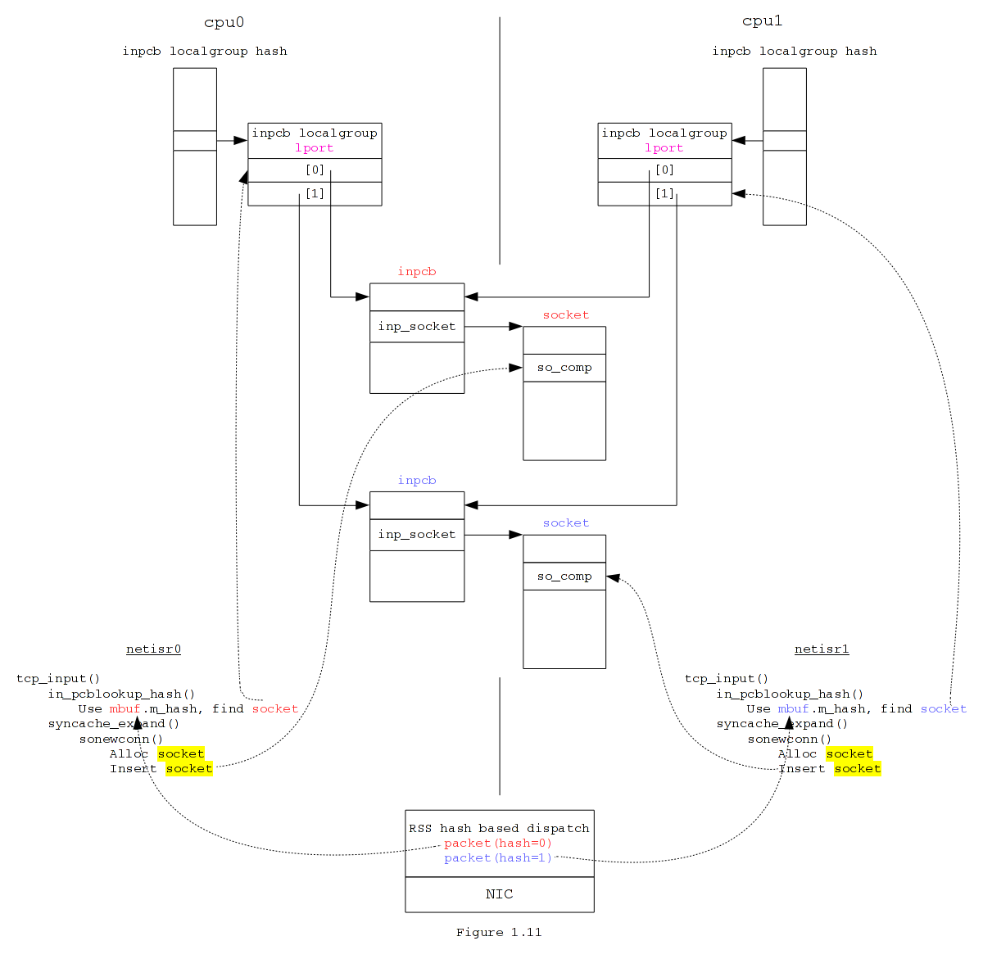
Google’s SO_REUSEPORT
Reincarnation in DragonFlyBSD
Solve the accept queue contention in a clean way.

Slide 19
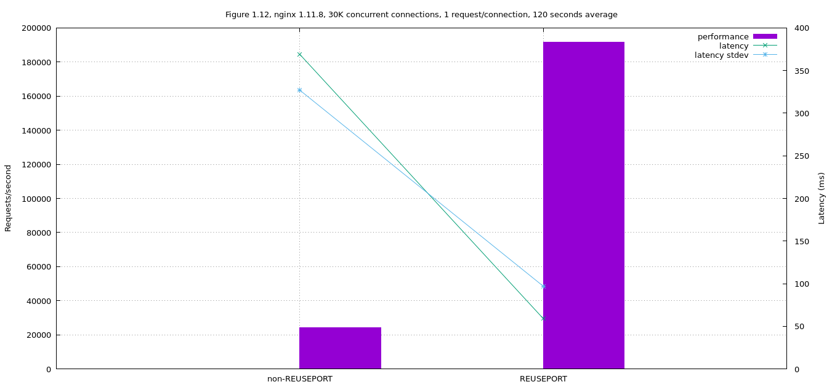
Google’s SO_REUSEPORT performance/latency, 1KB web object

Slide 20
NIC ring based polling(4)
polling(4) inherited from FreeBSD is NIC based.
Modern NICs have multiple RX/TX rings.
ifnet.if_npoll().
Upper layer calls ifnet.if_npoll() to enter/exit polling(4).
NIC driver implements ifnet.if_npoll() to register:
Polling function.
Ring as the polling function’s argument.
net/if_poll.c takes care of the rest.

Slide 21
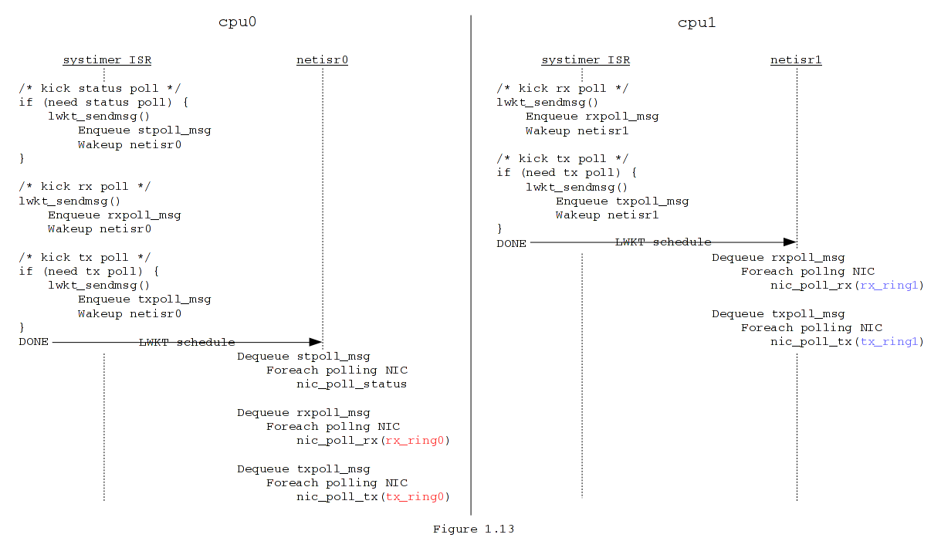
NIC ring based polling(4) example polling workflow

Slide 22
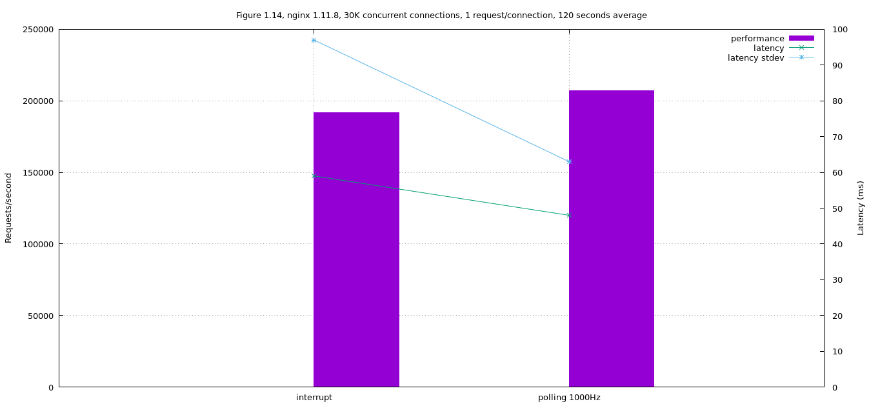
NIC ring based polling(4) performance/latency, 1KB web object

Slide 23
NIC ring based polling(4)
Easter eggs
# of usable rings will not be limited by # of MSI-X vectors.
Intel 82576, 16 pair of RX/TX rings, 10 MSI-X vectors.
All of the RX/TX rings can be used with polling(4), if # of CPUs >= 16.

Slide 24
Some useful TCP features
RFC6675 instead of NewReno.
If SACK is available.
Eifel detection (RFC3522).
Detect false retransmission.
Eifel response (RFC4015).
Recover from false timeout.
NCR (RFC4653).
Avoid false fast retransmission.
1 second initial RTO (RFC6298).
Per-routing IW setting.
RFC6928, aka IW10.
Default IW is increased from 3 to 4.

Slide 25
Performance
Comparison of DragonFlyBSD and other OSes.
DragonFlyBSD.
719bf70a37139bc3bedc84ab0975df7107155714.
Label: dragonfly.
Label: dragonfly-invariant, kernel with “options INVARIANTS”.
FreeBSD.
Label: freebsd, r314268, GENERIC-NODEBUG.
Linux.
Label: linux3.10, Linux centos7 3.10.0-514.6.2.el7.x86_64.
Label: linux4.9, Linux deb 4.9.0-1-amd64, with 24 RX/TX rings.
Label: linux4.9-16rxring, Linux deb 4.9.0-1-amd64, with 16 RX/TX rings.

Slide 26
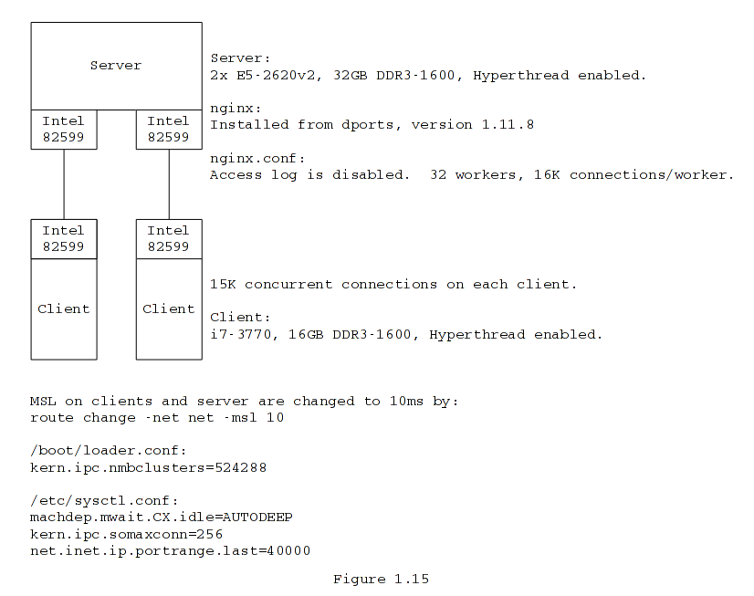
Performance HTTP/1.1 short lived connections
Configuration:
Nginx ‘reuseport’ is enabled on DragonFlyBSD and Linux.
Not applicable to FreeBSD.
DragonFlyBSD polling(4) @1000Hz.
Linux tuning.
Firewall is disabled.
SELinux is disabled.
NOFILE is increased to 40960 both system-wise and for each nginx worker.
net.core.netdev_max_backlog=65535
net.core.somaxconn=256

Slide 27
Performance HTTP/1.1 short lived connections
HTTP/1.1 traffic generator:
https://github.com/sepherosa/wrk
sephe/wrk branch.
Each client ran:
wrk -c 15000 -t 8 -d 120s --delay --latency --connreqs 1 http://server/X_K.bin
Each client can generate 160Krequests/s.
1K.bin, 8K.bin, and 16K.bin are static files.
DragonFlyBSD on hammerfs.
Linux on ext4.
FreeBSD on UFS2.

Slide 28
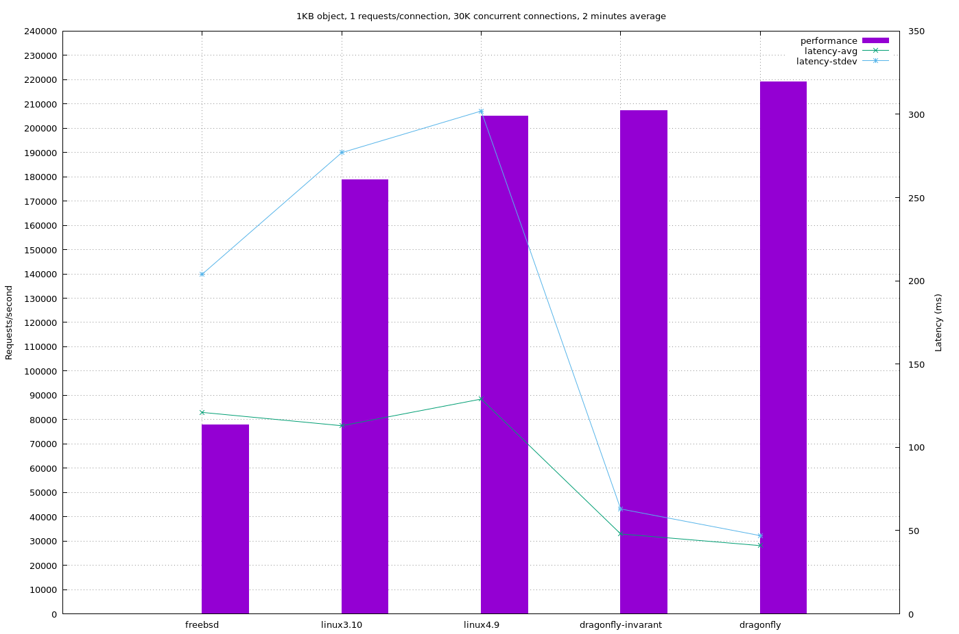
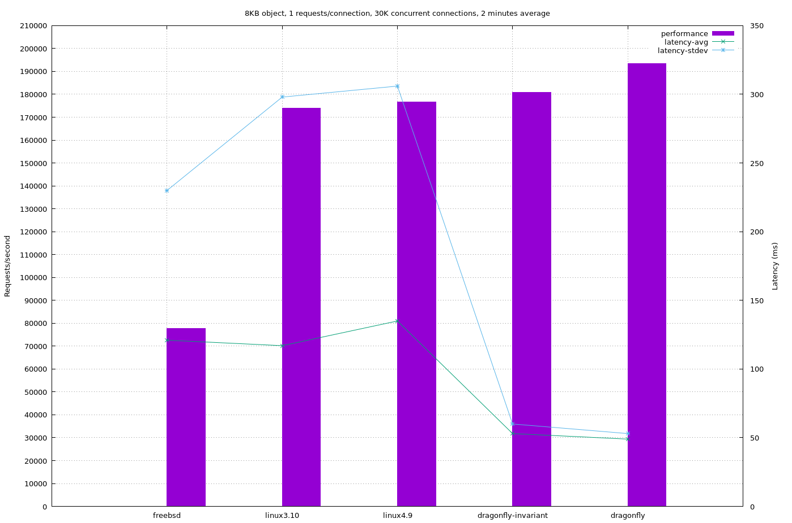
Performance HTTP/1.1 short lived connections

Slide 29
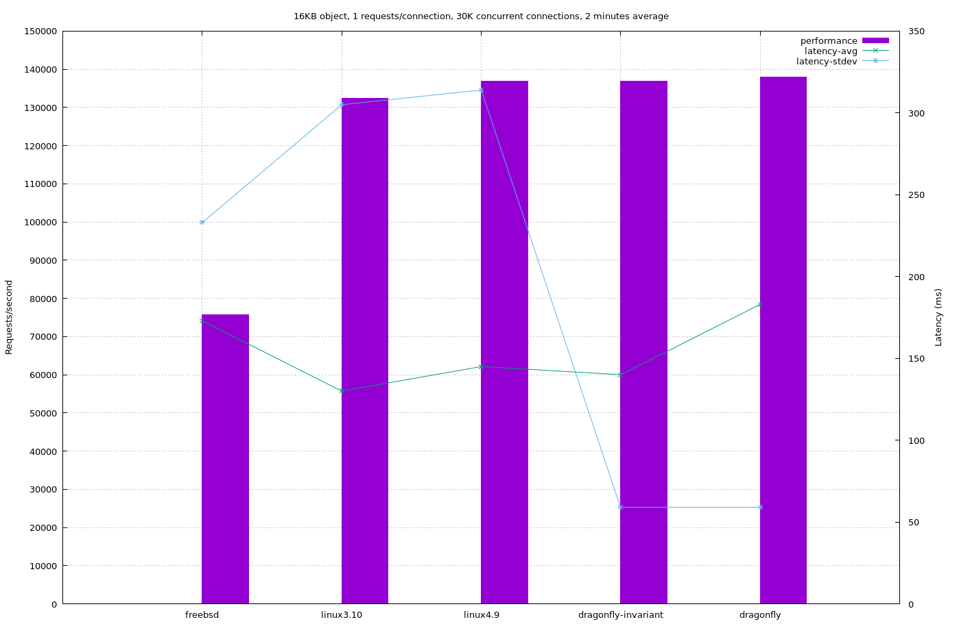
Performance HTTP/1.1 short lived connections
DragonFlyBSD and Linux 4.9 reach 9.5Gbps on each NIC with 16KB web object.

Slide 30
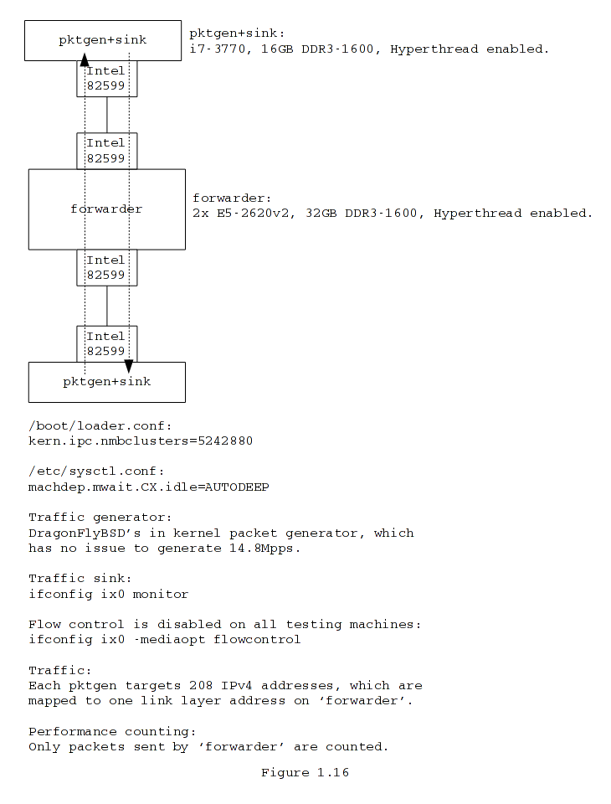
Performance Bi-directional IPv4 forwarding
Configuration:
DragonFlyBSD polling(4).
6000Hz, default polling rate.
Reserved 5% cpu time for userspace.
Linux tuning.
Firewall is disabled.
SELinux is disabled.
net.core.netdev_max_backlog=65535

Slide 31
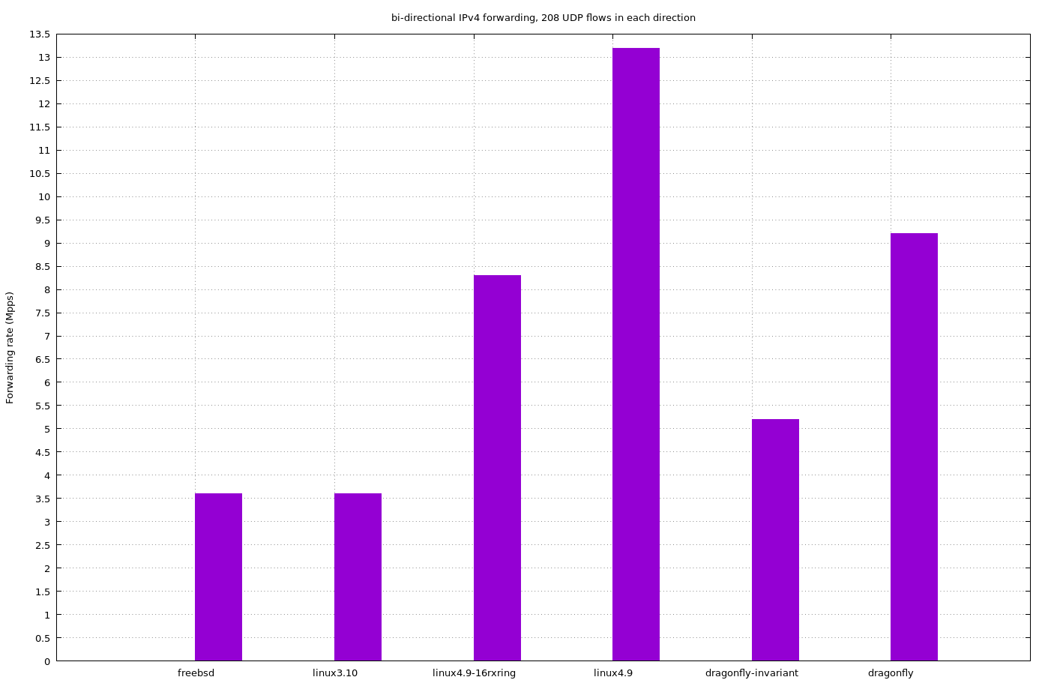
Performance Bi-directional IPv4 forwarding
DragonFlyBSD is impacted quite a lot by ‘options INVARIANTS’ for this test.
Linux 4.9 Intel 82599 driver uses “flow director”.
Can use all 64 RX/TX rings.
24 RX/TX rings are used here.
Not RSS, i.e. DragonFlyBSD cannot use it.
Just for comparison purpose, Linux 4.9 using 16 RX/TX rings (linux4.9-16rxring) is benched.
Slower than DragonFlyBSD with the same number of RX/TX rings.

Slide 32
Chapter 2 The evolution of DragonFlyBSD’s network stack

Slide 33
Back in 2006
Mbuf object cache.
Accelerated mbuf cluster allocation.
3 network threads on each CPU.
UDP-N, TCP-N and netisr-N.
Synchronous message passing for UIPC syscalls.
DragonFlyBSD’s IPIQ was used for message passing.
Network data were replicated and partitioned.
Home-made 4-tuple commutative hash.
Used to partition network data.
Everything was under BGL.

Slide 34
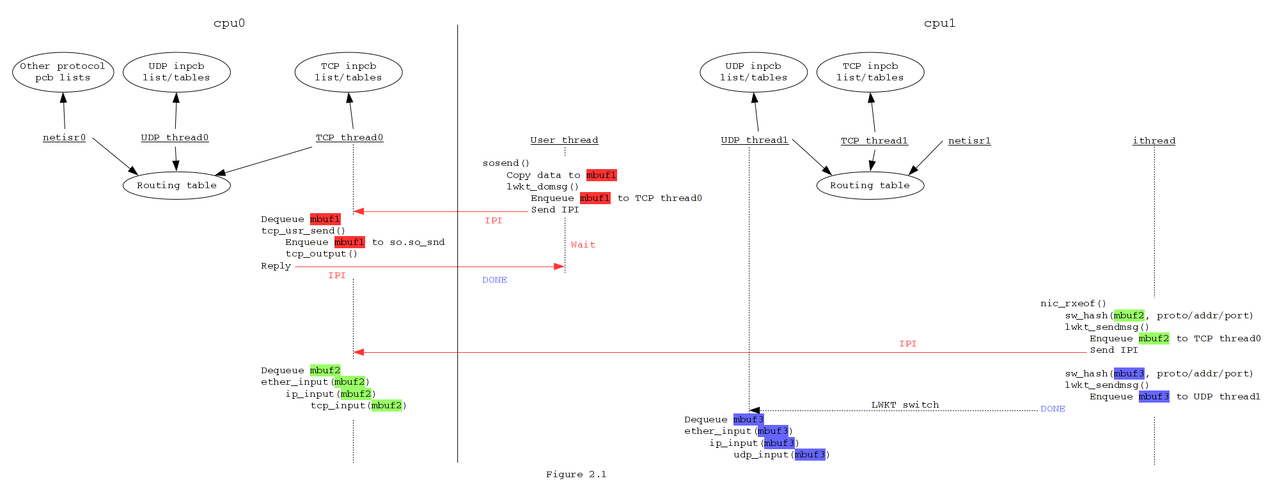
Back in 2006

Slide 35
Packet batching in 2008
Removal of BGL started.
Issue popped up.
Most of the commodity NICs only had 1 RX ring in 2008.
Received packets were distributed to available CPUs.
Use DragonFlyBSD’s IPIQ to do the packet distribution.
Protocol processing time >> IPIQ processing time.
IPI avoidance mechanism is not efficient in this case.
Almost one IPI for one packet.

Slide 36
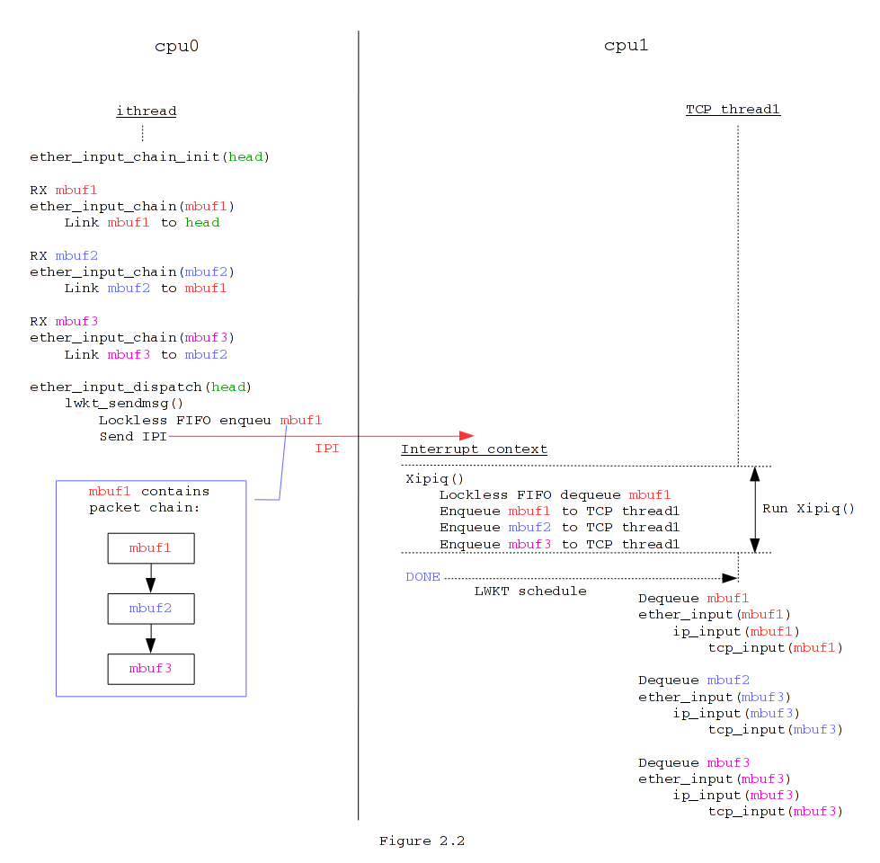
Packet batching in 2008
Explicit IPI avoidance.
Aggregate received packets.
Use IPI to distribute packet “clip”.
Precondition:
Most of the NICs have interrupt moderation.
Packets could be aggregated.
Interrupt threads are not preempted.
No scheduling induced latency.

Slide 37
Packet batching in 2008
Gave ~10% packet forwarding rate improvement.
On old commodity hardware, ~500Kpps -> ~550Kpps.
Lesson we learned:
Avoid IPI, if possible.
Batching/aggregation is an efficient way to avoid IPI.
Peek forward:
Switched to spinlock message port in 2011.
Efficient wakeup IPI avoidance.

Slide 38
Introduction of symmetric RSS in 2009
Symmetric RSS.
Used to partition network data.
Raised by Hasso Tepper, about the multiple RX ring support.
Intel 82571, 2 RX rings.
Widely available.
Made default in 2010.
Device drivers support:
bce(4), bnx(4), emx(4), igb(4), ix(4), jme(4), mxge(4) …
Software RSS hash for 1 RX ring devices.

Slide 39
Single per-cpu network thread in 2010
Removal of BGL.
Issue popped up:
Non-interrupt kernel threads do not preempt each other.
3 network threads on the same CPU.
Lock out others under high network load.
Mbuf sitting on the locked-out network threads’ message port.
Solution:
1 network thread on each CPU, aka netisr-N.

Slide 40
Single per-cpu network thread in 2010
Lesson we learned:
Multiple per-cpu threads handling almost same kind of tasks probably do not play well together.

Slide 41
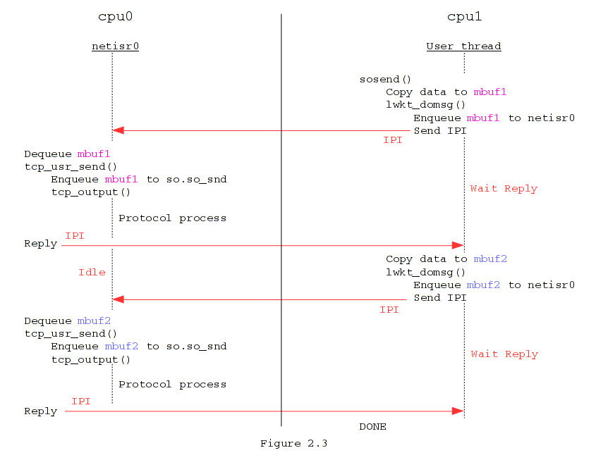
Asynchronous message passing for UIPC syscalls since 2011
Drawback of synchronous message passing.
High scheduling cost.
As noted by Paul Willmann, Scott Rixner and Alan L. Cox in their USENIX 2006 paper.
Excessive wakeup IPIs.
Waste free CPU cycles.

Slide 42
Asynchronous message passing for UIPC syscalls since 2011
Took sendto(2) as the first step.
Return values of sendto(2).
Not widely used.
UDP sending errors. Linux always returns 0.
Actually asynchronous.
TCP sending errors. Connection dropped.
Always return 0 for sendto(2) on NONBLOCK socket.
If so_snd is not full.
No asynchronous error.

Slide 43
Asynchronous message passing for UIPC syscalls since 2011 with spinlock message port

Slide 44
Asynchronous message passing for UIPC syscalls since 2011
Why switch to spinlock message port then?
Built-in wakeup IPI avoidance.
Solves tricky message ordering issue.
Only happens with asynchronous message passing for UIPC syscalls.

Slide 45
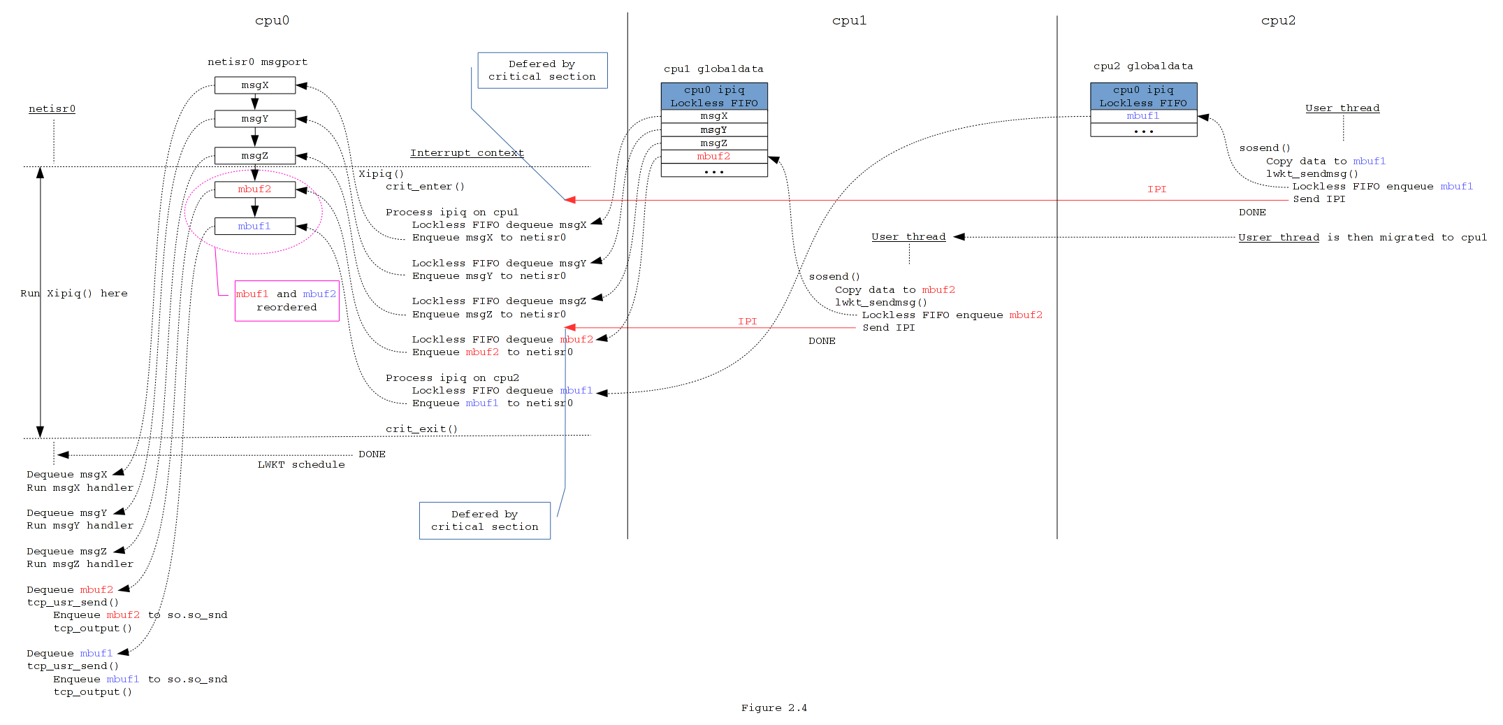
Asynchronous message passing for UIPC syscalls since 2011
Illustration of message ordering issue with thread message port

Slide 46
Asynchronous message passing for UIPC syscalls since 2011
Most of the UIPC syscalls used on application hot path are asynchronous.
socket(2), close(2).
accept(2), connect(2).
accept(2) for TCP listen socket no longer uses message.
Send syscalls, sendfile(2), recv syscalls.
so_pru_rcvd() from TCP socket recv syscalls is asynchronous.
Some setsockopt(2) options.
e.g. IPPROTO_TCP/TCP_NODELAY.

Slide 47
Asynchronous message passing for UIPC syscalls since 2011
Performance improvement is promising.
e.g. asynchronous setsockopt(IPPROTO_TCP, TCP_NODELAY).
nginx 1.9.12, short lived HTTP/1.1 (1 request/connection).
19% performance improvement, 156Kreqs/s -> 186Kreqs/s.
And we are still moving on!

Slide 48
Asynchronous message passing for UIPC syscalls since 2011
Asynchronous message passing for UIPC syscalls.
Use spinlock message port for message passing.
Lesson we learned:
Asynchronous message passing is an essential part of a performant messaging system.

Slide 49
Statistics maniac in 2013
Discovered during a round-up of IPv4 forwarding improvement cycle:
One commit makes ifnet statistics per-cpu.
Give the greatest performance improvement.
Improved even more than multiple TX ring support.
Lesson we learned:
Don’t over look the globally shared statistics updated at high frequency.
Some of Matthew Dillon’s VM work in 2017 reaches the same conclusion.

Slide 50
Rebirth of SO_REUSEPORT in 2013
Google implemented new SO_REUSEPORT semantics for Linux.
Aggelos Economopoulos brought it up to me.
Well, I don’t keep my head above water often.
Clean design and low hanging fruit for DragonFlyBSD.
Implemented within one week.
Patched nginx. Available through dports before nginx folks merged the patch.
Great performance improvement and latency reduction.
Pretty good lesson to me:
Open more eyes to what’s going on around.

Slide 51
Acrobatic UDP in 2014
The socket APIs for UDP is tOOOooo… flexible for DragonFlyBSD.
connect/disconnect.
Connected INPCB <-> wildcard INPCB.
Send datagrams on an unconnected UDP socket.
Making it MPSAFE and performant goes through complex process…
But, we made it ☺.

Slide 52
Help hands are needed
The IPsec stack.
The IPv6 stack.
Progress is slow from my side.
pf static rule table replication.
pf/ipfw state table partition.
And many other non-network related stuffs, like dports.
We can be reached through the mailing list, or IRC #dragonflybsd on Efnet.

